Slide 1
Fuzzing
CS 361S
Spring 2020
Seth James Nielson

Slide 2
What is Fuzzing?
Definition 1 (Fuzzing). Fuzzing is the execution of the Program Under Test [PUT] using input(s) sampled from an input space (the “fuzz input space”) that protrudes the expected input space of the PUT.

Slide 3
In English Please
Testing a program with unusual inputs

Slide 4
Three More Definitions
Definition 2 (Fuzz Testing). Fuzz testing is the use of fuzzing to test if a PUT violates a security policy.
Definition 3 (Fuzzer). A fuzzer is a program that performs fuzz testing on a PUT
Definition 4 (Fuzz Campaign). A fuzz campaign is a specific execution of a fuzzer on a PUT with a specific security policy.

Slide 5
Why Campaigns?
Goal: Find a bug that violates the security policy
Example: Bug causes a crash
Any security policy that is EM-Enforcable

Slide 6
EM-Enforcability
Fred Schneider: Enforceable Security Policies
The practicality of any security policy depends on whether that policy is
enforceable
and at what cost
EM: Enforcement by Eexecution Monitoring

Slide 7
Execution Monitoring
… the class of enforcement mechanisms that work by monitoring execution steps of some system, herein called the target, and terminating the target’s execution if it is about to violate the security policy being enforced. We call this class EM, for Execution Monitoring. EM includes security kernels, reference monitors, firewalls, and most other operating system and hardware-based enforcement mechanisms that have appeared in the literature
Not exactly what is described in the Fuzzing paper.

Slide 8
Bug Oracle
Definition 5 (Bug Oracle). A bug oracle is a program, perhaps as part of a fuzzer, that determines whether a given execution of the PUT violates a specific security policy.

Slide 9
Fuzz Configuration
Definition 6 (Fuzz Configuration). A fuzz configuration of a fuzz algorithm comprises the parameter value(s) that control(s) the fuzz algorithm.

Slide 10
Taxonomy of Fuzzers
Black Box: No access to internals
White Box: Based on relatively complete internal information
Grey Box: Based on limited or partial information

Slide 11
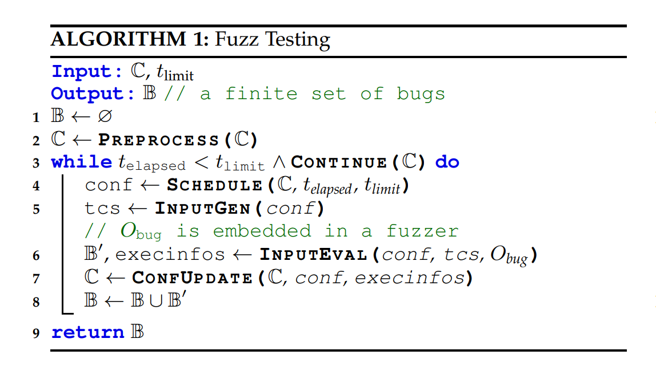
Generic Fuzz Algorithm

Slide 12
Fuzz Testing Routines
Preprocess: modified configuration, such as instrumentation
Schedule: limit time of execution and updates current iteration
InputGen: produce input based on configuration
InputEval: generates output and tests with a bug oracle
ConfUpdate: potentially update configurations based on output
Continue: determines whether testing should continue

Slide 13
Preprocess: Instrumentation
Static and Dynamic options
Execution Feedback
In-Memory Fuzzing
Thread Scheduling

Slide 14
Preprocess: Seed Selection
Seed Selection Problem
Minimal seeds for maximal coverage

Slide 15
Preprocess: Misc
Seed Trimming: Reduce the size of a seed
Driver Preparation: Prepare for test

Slide 16
Scheduling
More than just a for loop
Goal: pick the next configuration with best outcome
Example: maximum unique bugs
Example: best code coverage
Fuzz Configuration Scheduling (FCS): exploration v exploitation
Variations based on time elapsed v time budget
Gray box has more information available than black box

Slide 17
Input Generation
Generation-based (generally model-based)
Pre-defined model
Inferred model
Encoder model
Mutation-based (generally model-less)
Bit flipping
Arithmetic mutation
Block-based mutation
Dictionary-based mutation

Slide 18
Whitebox Fuzzers
Either model or model-less
Dynamic symbol execution
Guided fuzzing
PUT mutation

Slide 19
Input Evaluation: Bug Oracles
Memory and Type Safety
Undefined behaviors
Input validation
Semantic difference

Slide 20
Input Evaluation: Triage
Deduplication
Prioritization and Exploitability
Test case minimization

Slide 21
Input Evaluation: Execution Optimizations
Improve repeat execution performance
Shorten start-up times
Potential relationship with in-memory fuzzing

Slide 22
Configuration Update
Evolutionary Seed Pool Update
Maintaining a miniset

